Slide 1
Molecular Biology Biol 480
Lecture 18 March 1st , 2019

Slide 2
Announcements/Assignments
Good lab! We will run agarose gels next week. Be sure to bring and use lab journals during lab. Be ready to independently make gels and know what to expect for YOUR PCR fragments.
Handing out presentation assignment today. Read. We will discuss Wednesday
Exam 2 March 4th. Topics today
No lecture March 8th. This is the ND Academy of Science meeting in Grand Forks.

Slide 3
Where were we?
Transcription regulation in eukaryotes
Parts of the eukaryotic gene promoter—Core elements, proximal and distal elements. (Cis elements)
Transcription factors! (Trans elements)
Basal level transcription factors for eukaryotic RNA pol. II.

Slide 6
A general look…

Slide 7
Distant regulation
Finally, transcription initiation may require additional, cell-specific TFs that bind sequences outside the promoter.
A common cis element that boosts the rate of transcription initiation significantly is called an enhancer.

Slide 9
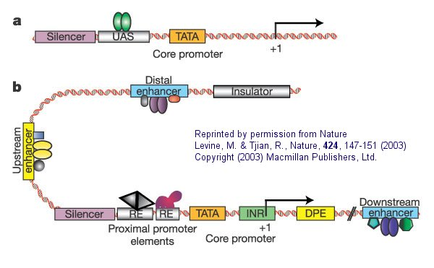

Slide 10
The current idea on how enhancers enhance transcription is that the sequences attract and bind activator proteins.
Through a looping out of DNA between the enhancer and promoter, the activator protein(s) does make contact with the basal TFs, which somehow starts the RNAP II transcribing the gene.

Slide 11
We’ve learned that transcription initiation is a pretty complicated matter. A lot of proteins (trans elements) must meet up at the right place (the cis elements of the gene) and at the same time.
Why would such a complex system be used?
After all, our cells must have a constant supply of RNAs and proteins to carry out all the activities they use to function as cells.

Slide 12
1. Energy conservation
Transcription and translation require a constant supply of building blocks and energy. Cells can’t be wasteful, making macromolecules that aren’t needed all the time.
2. Specialization
Cells make a specific subset of RNAs and proteins that allow them to do specific activities. Transcription initiation regulation is the primary mechanism for controlling gene expression.

Slide 13
Specialization is, in large part, controlled with those elements that act at a distance—the enhancers and the activator proteins that bind them.
We will return to this soon!

Slide 14
Before we move on, let’s consider how cis and trans elements “hook up”.
Why/how does a particular trans element find and bind to a particular cis element?
---Non-covalent interactions!

Slide 15
Specific amino acids in the protein trans element bind with specific nucleotide base components in the DNA.
These DNA binding trans element proteins often have a specific folded shape that allow them to contact the DNA in specific ways.

Slide 16
For example
The green transcription factor is binding the DNA double helix with specific amino acids in 2 different helical areas (of the protein).
The transcription factor is nestled in the major grooves of the DNA helix.

Slide 18
We will study more of these DNA binding proteins soon. They have cool names that describe a shape that allows them to bind DNA.
Helix-loop-helix
Helix-turn-helix
Leucine zipper
Zinc finger

Slide 19
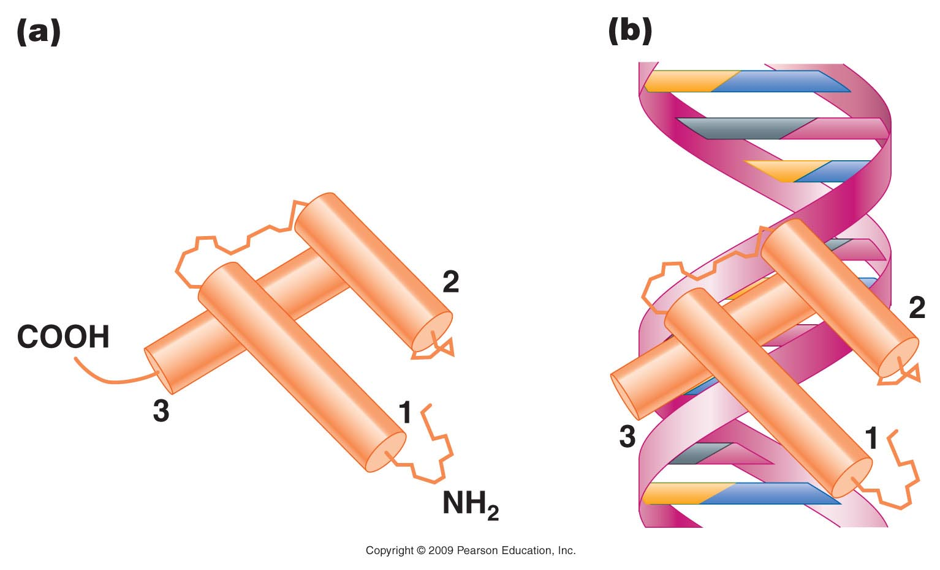
Figure 18.11
Notes:
Figure 18-11 A helix–turn–helix or homeodomain in which (a) three planes of the α-helix of the protein are established, and (b) these domains bind in the grooves of the DNA molecule.

Slide 20
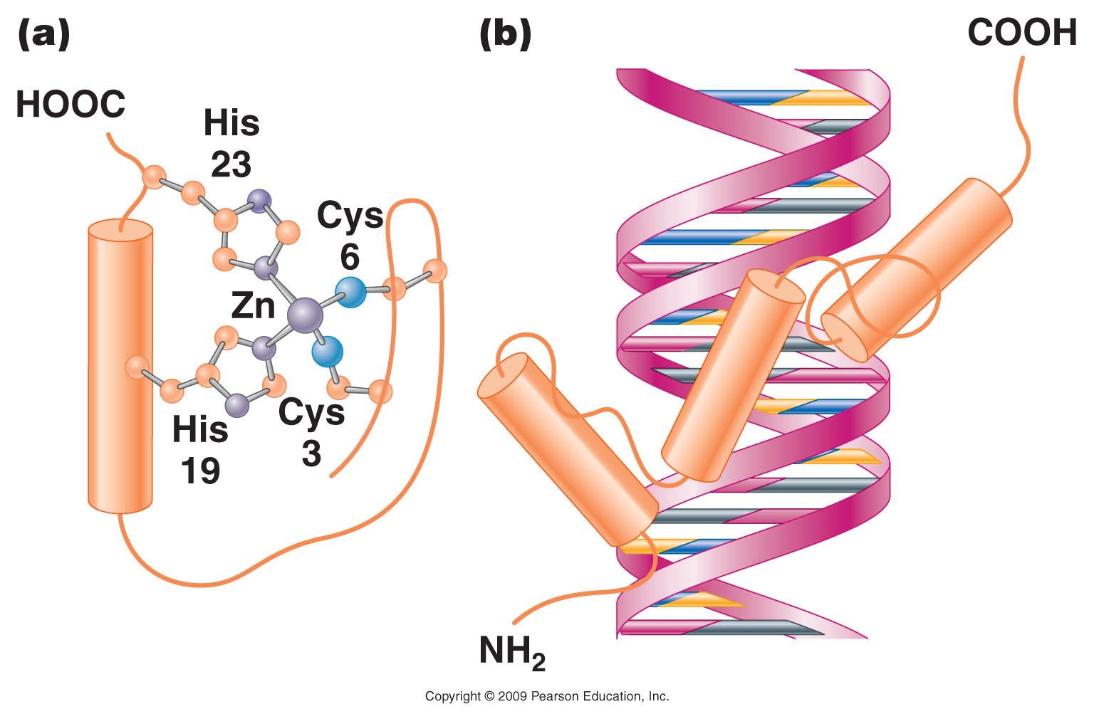
Figure 18.12
Notes:
Figure 18-12 (a) A zinc finger in which cysteine and histidine residues bind to a Zn²⁺ atom. (b) This loops the amino acid chain out into a fingerlike configuration.

Slide 21
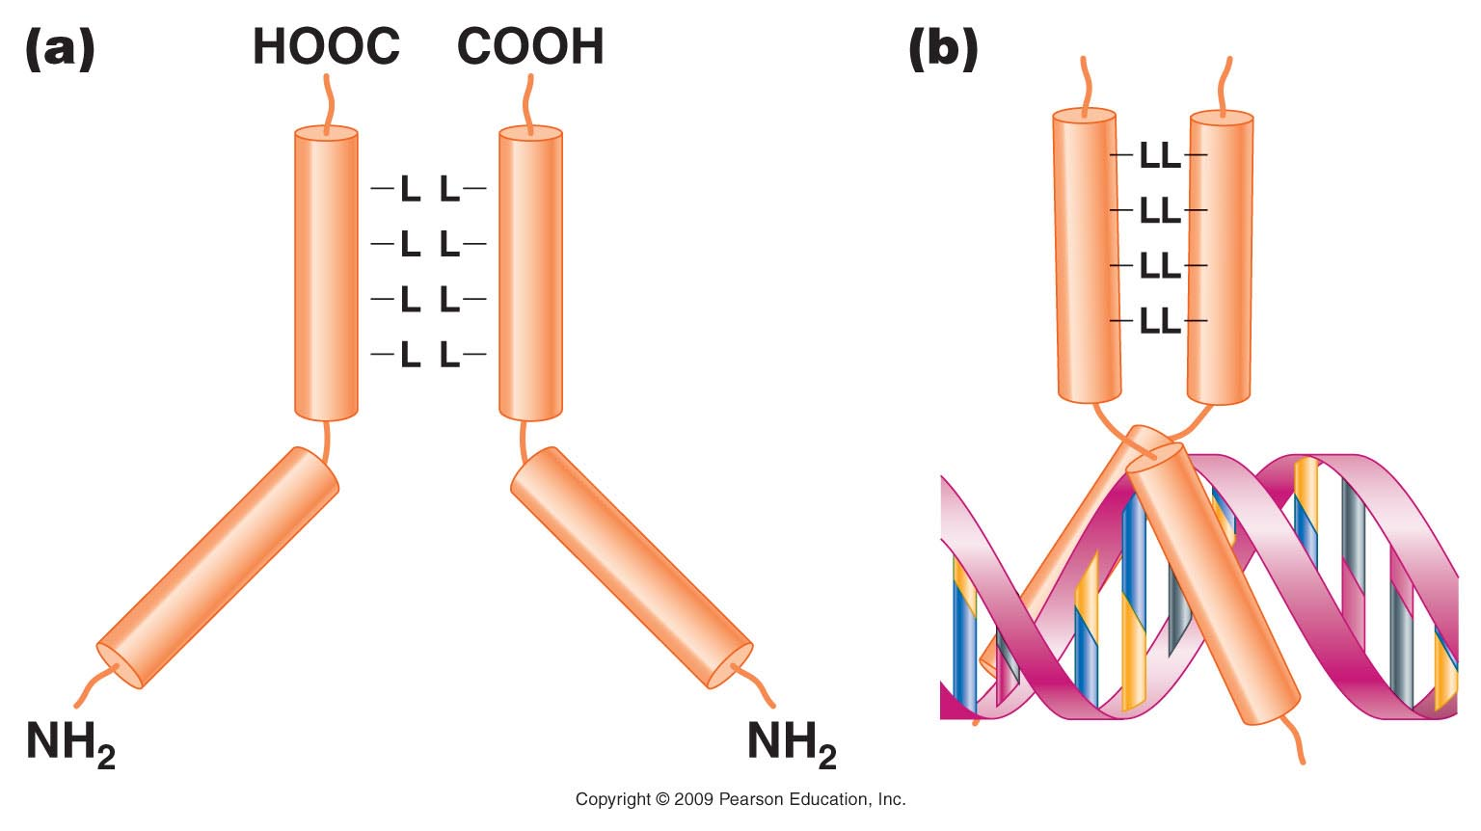
Figure 18.13
Notes:
Figure 18-13 (a) A leucine zipper is the result of dimers from leucine residue at every other turn of the -helix in facing stretches of two polypeptide chains. (b) When the -helical regions form a leucine zipper, the regions beyond the zipper form a Y-shaped region that grips the DNA in a scissorlike configuration.

Slide 22
Let’s step back and think about basic details in transcription in eukaryotes.
Thus far we have focused on transcription initiation.

Slide 23
Transcription in eukaryotes Some significant differences from prokaryotes
1. Occurs in a compartment (nucleus), that is separated from translation machinery.
2. Initiation is more complex. Cis elements of genes are more abundant and more variable. Initiation involves more cis-elements and therefore, more types of trans elements.
3. In general, genes are monocistronic, but able to be spaced further apart in a larger genome

Slide 24
mRNA (RNA that gets translated)
4. The RNA produced is not ready for translation.
1. It must be transported to the cytoplasm, the location of the ribosomes
2. It must be modified in a number of ways---a process called RNA processing.
*These are post-transcriptional modifications!

Slide 25
RNA processing
5’ modification---addition of a modified guanosine tri-phosphate.
3’ modification---cleavage of 3’ end and addition of a poly A sequence.
Internal modification---removal of RNA known as introns and splicing together adjacent RNA known as exons. (RNA splicing)

Slide 26
Study this!

Slide 27
Addition of the poly-A tail is made—it is the combined job of a cutting enzyme (an endonuclease) and a special polymerase (poly A polymerase)
http://en.wikipedia.org/wiki/Polyadenylation

Slide 28
Another consensus sequence that communicates something to a protein!

Slide 29
Most of the modifications are completed prior to export from the nucleus---and some modifications are in fact required for export.
mRNA transcribed from a given gene is thus fairly uniform once it has left the nucleus.
It is mostly sequence of amino acid code, with some untranslated RNA at its 5’ and 3’ end.

Slide 30
Conversely RNA in the nucleus, even that transcribed from a given gene, will NOT be uniform in size or sequence since different molecules of that RNA will be undergoing RNA processing. The different stages of RNA processing will yield RNAs of different sizes.
We therefore call the RNA found in the nucleus heterogeneous nuclear RNA (hnRNA)

Slide 31
mRNA splicing
Removal of non-amino acid coding RNA called introns.
Introns comes from “intervening sequence”
Connecting the non-contiguous RNA that codes for amino acids

Slide 32
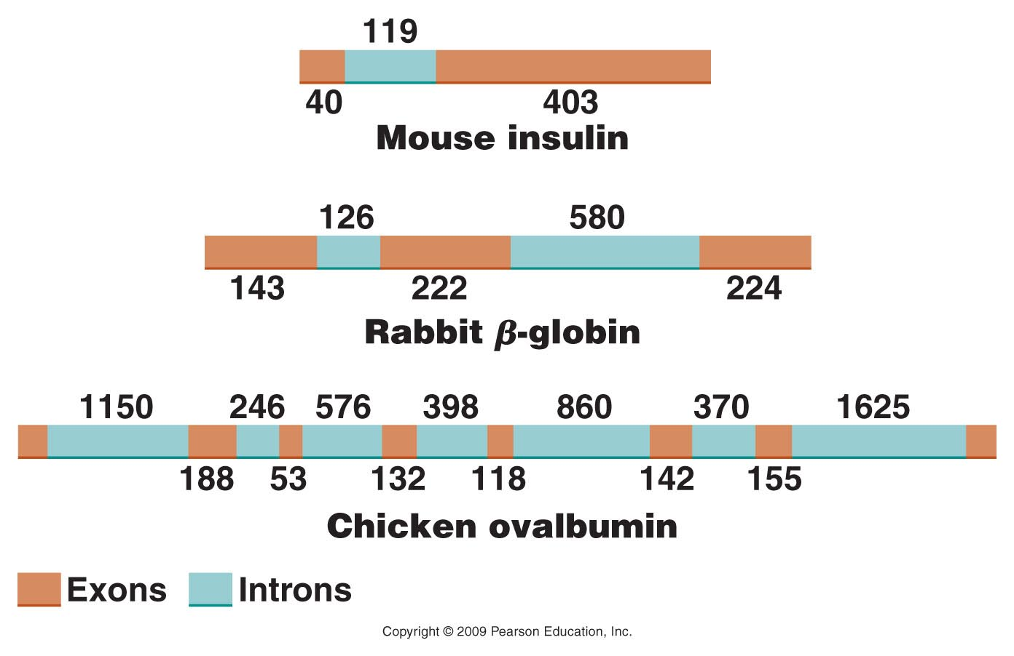
Figure 14.12
Notes:
Figure 14-12 Intervening sequences in various eukaryotic genes. The numbers indicate the number of nucleotides present in various intron and exon regions.

Slide 33
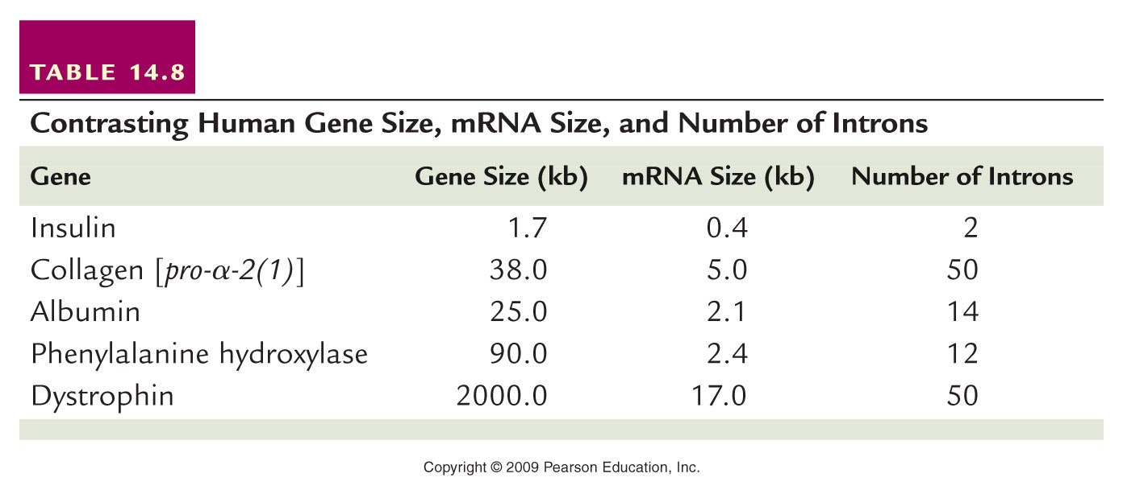
Table 14.8
Notes:
Table 14-8 Contrasting Human Gene Size, mRNA Size, and the Number of Introns

Slide 34
Most genes of eukaryotes have introns. The average number is ~8 introns/gene.
Some exceptions…Histone genes have no introns!
…We will return to splicing shortly…

Slide 35
Additional resources at NCBI (NCBI bookshelf)
http://www.ncbi.nlm.nih.gov/books/NBK9846/
READ!

Slide 36
Back to RNA splicing. Since introns are unique to eukaryotic genes and since much of the early work in transcription and translation was done in prokaryotes, the existence of introns was not even discovered until the 1970s

Slide 37
In 1977, three people, Susan Berget, Phil Sharp, and Richard Roberts noticed that a virus, in a family called adenovirus, made longer RNA molecules that were eventually shortened.
Using hybridization techniques and electron microscopy, they compared the longer and shorter RNAs and the RNAs to the DNA that encoded them.

Slide 38
They noted that specific portions of the DNA sequence were missing in the RNA.
Sharp referred to this as “split genes”. The genes were shown to be interrupted with non-amino acid coding, intervening sequences.
These were later termed introns.

Slide 39
(from the cytoplasm)

